Slide 1
C++ basics

Slide 2
What is c++?
C++ is a general-purpose programming language
What makes it such a versatile language is that it:
Supports object-oriented programming (OOP)
Has user defined data types (libraries)
Is incredibly fast (for reasons discussed later)
Is suitable for both low-level and high-level programming

Slide 3
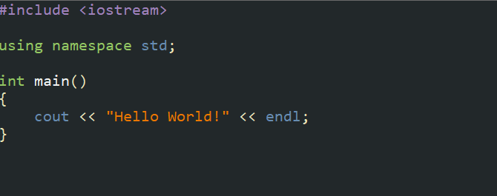
First code
Your first code will look something like this:

Slide 4
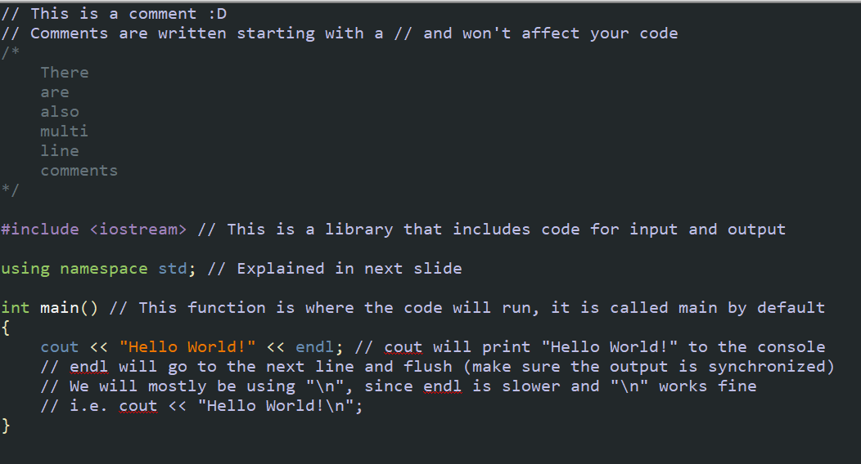
Run Down

Slide 5
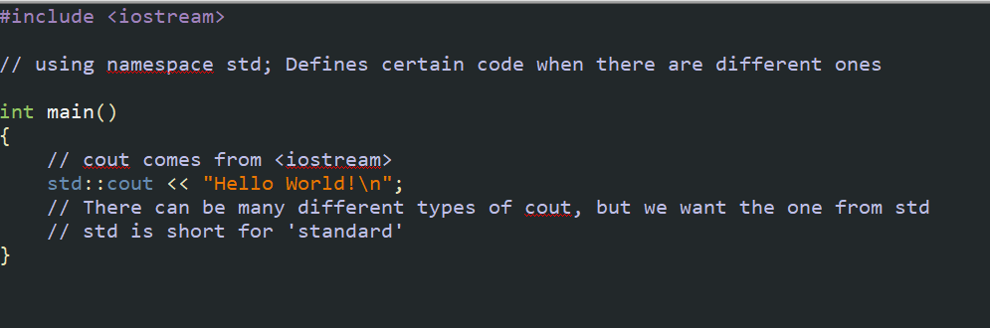
Using namespace std?
You don’t really need to know this, since you will normally put “using namespace std;” anyways but:

Slide 6
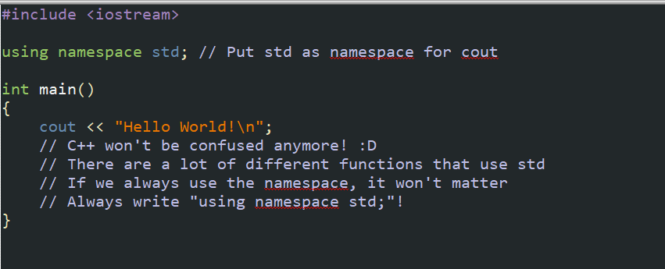
Using namespace std!

Slide 7
Data types

Slide 8
Data types
Data types hold a certain value, for example:
Type: | What it holds:
int | A whole number (1, 74, -18234239)
float | A decimal number (0.41, 3.14, 1.203923)
char | A character (‘a’, ‘B’, ‘]’, ‘#’)
boolean | A truth value (true (1), false (0))
long long | A bigger whole number (123423942349)
double | A bigger decimal number (3.14159265358979323)
string | A ‘string’ of characters (“Hello!”, “L8ER”, “11.293.23428.”)

Slide 9
Data type test
What type is it:
-4
-4.0
+4.0

Slide 10
binary

Slide 11
binary?
Binary is the name for the base-2 number system
Made up of 1s and 0s
Works the same as the base 10 number system
Base 10:
12345 = 1*10⁴ + 2*10³ + 3*10² + 4*10¹ + 5*10⁰
Base 2:
10110 = 1*2⁴ + 0*2³ + 1*2² + 1*2¹ + 0*2⁰ = 22 (base 10)

Slide 12
Floating Point numbers
Binary works with decimal points too!
0.10111 = 0*2⁰ + 1*2⁻¹ + 0*2⁻² + 1*2⁻³ + 1*2⁻⁴ + 1*2⁻⁵ = 23/32
The numbers do not continue on forever, so decimal numbers are not 100% accurate most of the time!
They might be off by 0.000000001 (base 10).
This inaccuracy is what we refer to as floating point numbers.

Slide 13
Bits and bytes
Bits is a binary digit, i.e. 0 or 1
Bytes are ‘collection’ of 8 binary digits, i.e. 11001100
All data types use bytes as value

Slide 14
Data types & Memory
Data types hold a certain value, for example:
Type: | How many bytes?
int | 4 bytes
float | 4 bytes
char | 2 bytes
bool (Boolean) | 1 byte*
long long | 8 bytes
double | 8 bytes
string | 2*# of character + ~40 bytes

Slide 15
Primitive vs user-created
Primitive means built-in, C++ created these data types
Primitive data types:
int
float
char
bool (Boolean)
long long
double
User-created is straightforward, people used primitive data types to create another data type
User-crated data types:
string

Slide 16
Operators

Slide 17
Arithmetic operators
Math operations in C++ involve the following the most:
Expression: | What it does:
+ | Adds a value
- | Subtracts a value
* | Multiplies by
/ | Divides by
% | After dividing, give the remainder

Slide 18
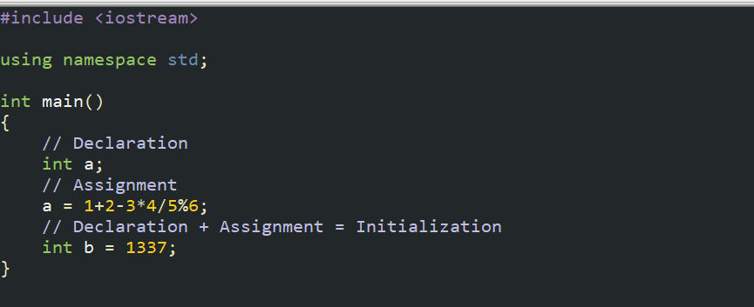
Variables
Think of a variable as a container that holds a value, and the data type is the type of value
Variables are names used for data types, creation goes as follows:

Slide 19
Assignment operators
Assignment operators modify a variable’s value
Expression: | What it does:
= | Assigns a value
A += B | Adds B onto A
A -= B | Subtracts B from A
A *= B | Multiplies A by B
A /= B | Divides A by B
A %= B | Modulo A by B
A++ | Increments A by 1
A-- | Decrements A by 1

Slide 20
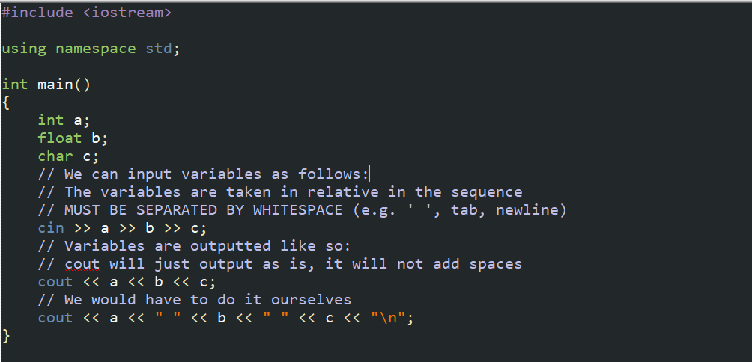
Input & output

Slide 21
If/else statements

Slide 22
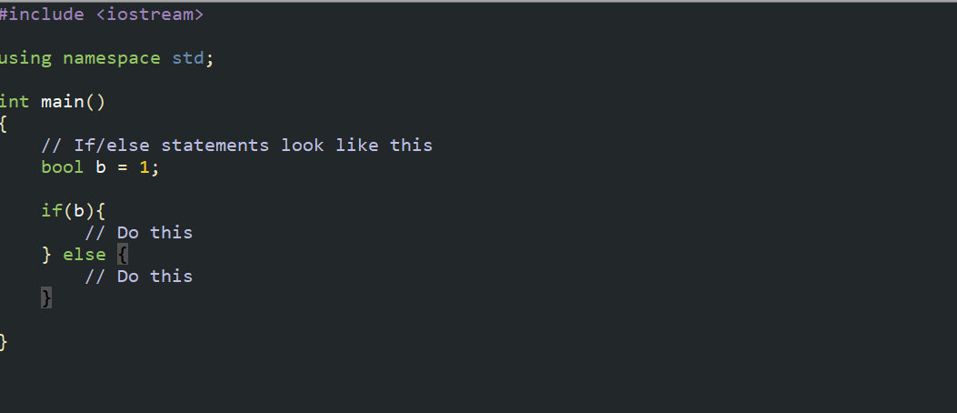
If else statements

Slide 23

How they work

Slide 24
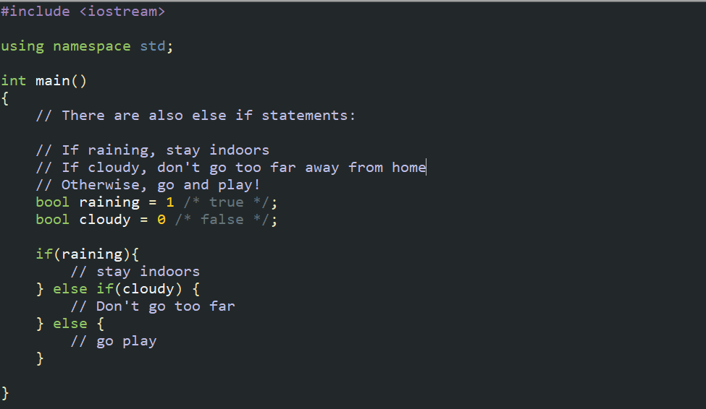
Else if statment

Slide 25
Boolean logic

Slide 26
Boolean logic
Booleans use logic to determine whether they are true or not
The condition for an if statement has to be true for it to run
We can compound conditions, and the whole thing has to be true for it to run
For example: If it is raining and you don’t have an umbrella, stay indoors

Slide 27
Boolean operators
Assignment operators modify a variable’s value
Expression: | What it does:
A == B | True if A is equivalent to B
A != B | True if A is not equivalent to B
A < B | True if A is less than B
A > B | True if A is greater than B
A <= B | True if A is less than or equal to B
A >= B | True if A is greater than or equal to B
A && B | True if both A and B are true
A || B | True if either A or B are true

Slide 28
Exercise
Take in an int variable
If it is greater than 0, output “POSITIVE”
If it is less than 0, output “NEGATIVE”
If it is equal to 0, output “ZERO”

Slide 29
Loops

Slide 30

While loop
Coding would be very tedious if we couldn’t repeat instructions in a systematic way.
Imagine outputting every integer from 1-100…
Luckily, we have the while loop!

Slide 31

For loop
We can do the same with another very useful loop called the for loop!

Slide 32
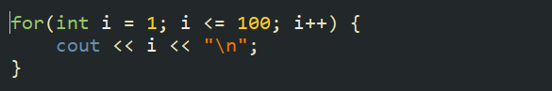
Similarities?
This is the same code!

Slide 33
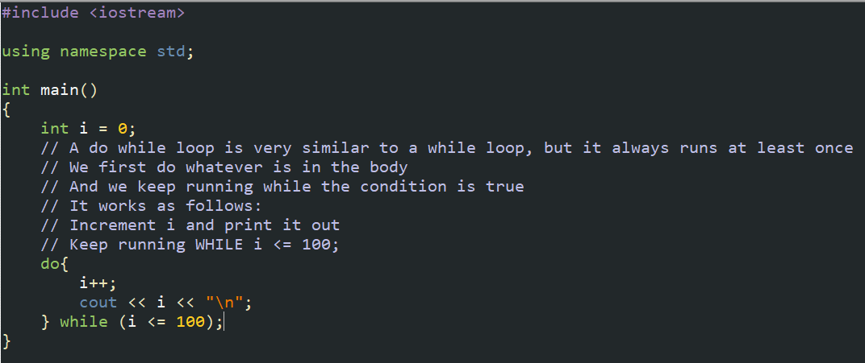
Do while loop

Slide 34
Loop commands
Two helpful loop commands:
1. break;
This will take you out of the loop
2. continue;
This will skip the rest of the stuff in the body, and continue with the next iteration of the loop

Slide 35
Exercise 1
Print out all the numbers from 1-100, with the following rules:
1. If the number is divisible by 3, print out “fizz”
2. If the number is divisible by 5, print out “buzz”
3. If the number is not divisible by either, print out the number
Example: 1 = 1, 3 = fizz, 15 = fizzbuzz

Slide 36
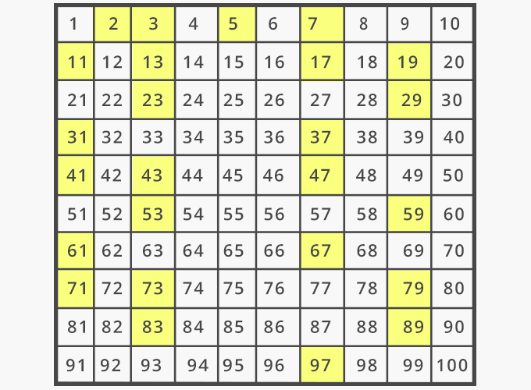
Exercise 2
Print out prime numbers from 1-100

Slide 37
Homework 1
Starting with a positive number n, it is conjectured the following sequence will always terminate:
1. If n is even, divide it by 2
2. If n is odd, multiply it by 3 and add 1
3. If n is 1, terminate the sequence
I want to know if this is true for numbers from 1 – 10000

Slide 38
Homework 2
Count the numbers from 1 – 100000
Can you make a program that does this quickly? (< ~2 seconds)
You need to include <math.h> (Also a hint)
It might take a little bit to load the program before hand, so print something at the start of the code (e.g. “Prime count:”)

